Slide 1
FEATURE SELECTION AND DATASET
INTRODUCTION
Prediction of Heart Attack
EDA
METHODOLOGY AND ALGORITHMS
CONCLUSION

Slide 2
SIGNIFICANCE
OBJECTIVE
Heart disease is one of the leading causes of death worldwide. Early prediction of heart attack risk can significantly improve patient outcomes by enabling timely medical intervention and lifestyle changes. By analyzing various medical and demographic factors, it is possible to develop a predictive model that can estimate the likelihood of a heart attack.
PROBLEM STATEMENT

Slide 3


OBJECTIVE
The objective of this project is to develop a machine learning model that can predict the risk of a heart attack based on a set of medical and demographic variables. The model will be trained on historical patient data and will aim to provide accurate predictions to aid healthcare professionals in assessing patient risk.

Slide 4
SIGNIFICANCE
OBJECTIVE
Heart disease is one of the leading causes of death worldwide. Early prediction of heart attack risk can significantly improve patient outcomes by enabling timely medical intervention and lifestyle changes. By analyzing various medical and demographic factors, it is possible to develop a predictive model that can estimate the likelihood of a heart attack.
PROBLEM STATEMENT

Slide 5


PROBLEM STATEMENT
We are analyzing various machine learning algorithms and finding the best to predict the presence or absence of heart disease. The target is binary classification which is '0' for absence and '1' for presence of heart disease.

Slide 6
SIGNIFICANCE
OBJECTIVE
Heart disease is one of the leading causes of death worldwide. Early prediction of heart attack risk can significantly improve patient outcomes by enabling timely medical intervention and lifestyle changes. By analyzing various medical and demographic factors, it is possible to develop a predictive model that can estimate the likelihood of a heart attack.
PROBLEM STATEMENT

Slide 7
FEATURE SELECTION AND DATASET
INTRODUCTION
Prediction of Heart Attack
EDA
METHODOLOGY AND ALGORITHMS
CONCLUSION

Slide 8


FEATURE
• age: Age of the patient
• sex: Sex of the patient (1 = male, 0 = female)
• cp: Chest pain type
• trestbps: Resting blood pressure (in mm Hg)
• chol: Serum cholesterol (in mg/dl)
• fbs: Fasting blood sugar (1 = fasting blood sugar > 120 mg/dl, 0 = otherwise)
• restecg: Resting electrocardiographic results
• thalach: Maximum heart rate achieved
• exang: Exercise-induced angina (1 = yes, 0 = no)
• oldpeak: ST depression induced by exercise relative to rest
• slope: Slope of the peak exercise ST segment
(0 = upsloping, 1 = flat, 2 = downsloping)
• ca: Number of major vessels (0-3) colored by fluoroscopy
• thal: Thalassemia
(3 = normal, 6 = fixed defect, 7= reversible defect)
• target: Target variable
(1 = heart attack risk, 0 = no risk)
Dataset Screenshot

Slide 9
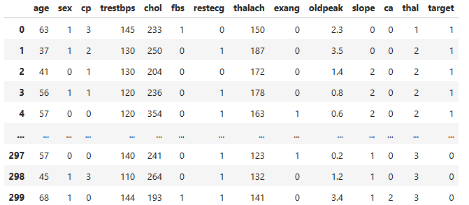
Dataset Screenshot

Slide 10
FEATURE
• age: Age of the patient
• sex: Sex of the patient (1 = male, 0 = female)
• cp: Chest pain type
• trestbps: Resting blood pressure (in mm Hg)
• chol: Serum cholesterol (in mg/dl)
• fbs: Fasting blood sugar (1 = fasting blood sugar > 120 mg/dl, 0 = otherwise)
• restecg: Resting electrocardiographic results
• thalach: Maximum heart rate achieved
• exang: Exercise-induced angina (1 = yes, 0 = no)
• oldpeak: ST depression induced by exercise relative to rest
• slope: Slope of the peak exercise ST segment
(0 = upsloping, 1 = flat, 2 = downsloping)
• ca: Number of major vessels (0-3) colored by fluoroscopy
• thal: Thalassemia
(3 = normal, 6 = fixed defect, 7= reversible defect)
• target: Target variable
(1 = heart attack risk, 0 = no risk)
Dataset Screenshot

Slide 11
FEATURE SELECTION AND DATASET
INTRODUCTION
Prediction of Heart Attack
EDA
METHODOLOGY AND ALGORITHMS
CONCLUSION

Slide 12
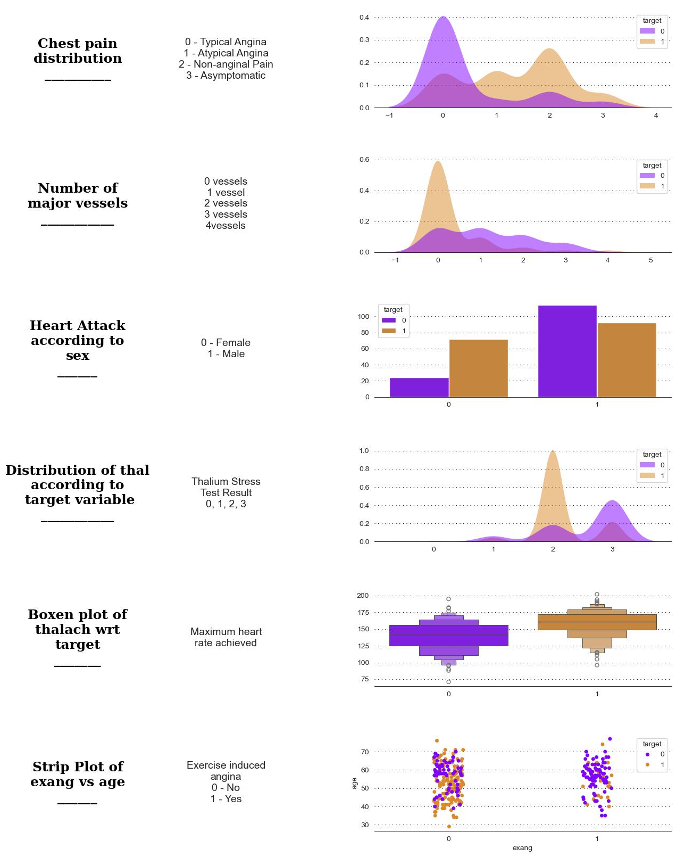
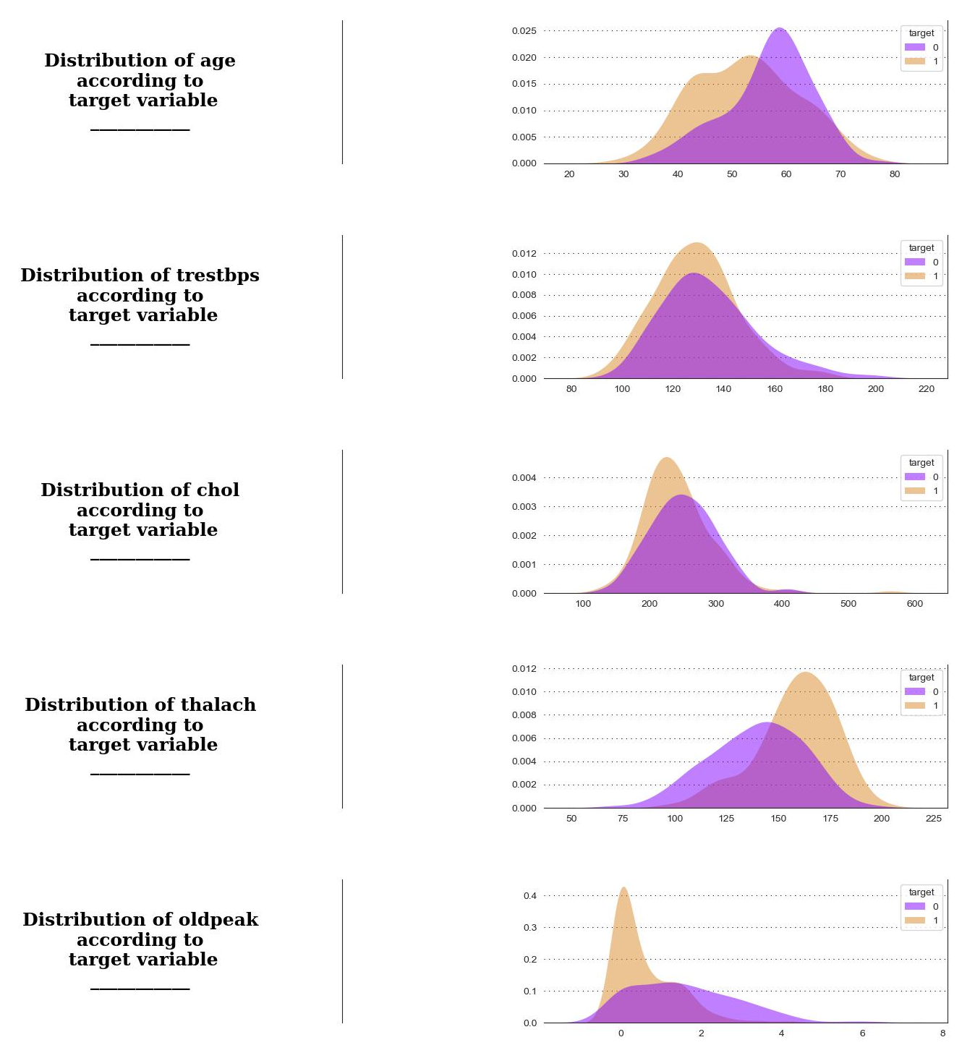
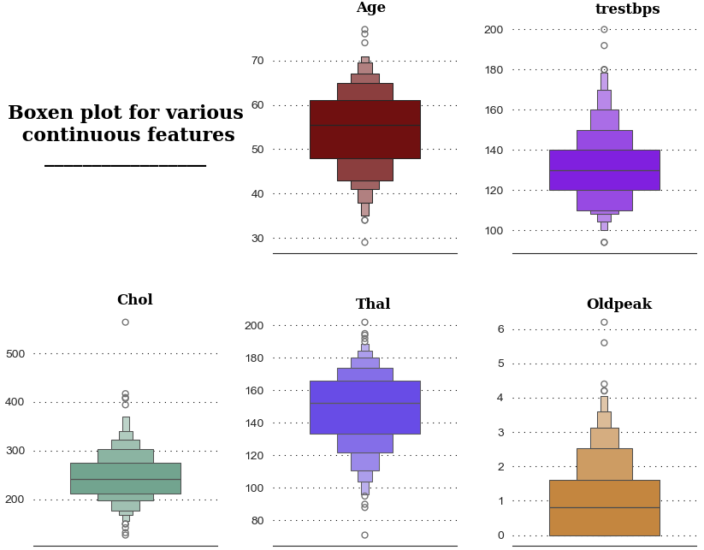
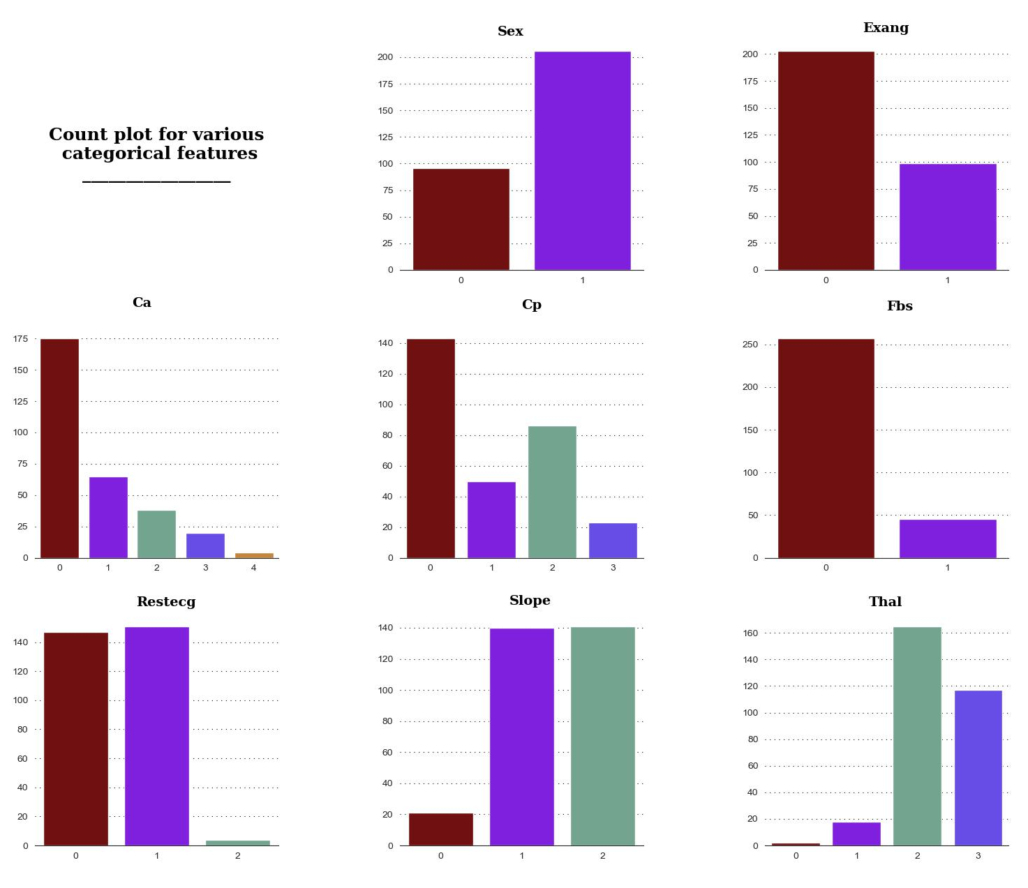
EDA
There are no NaN values in the data.
There are certain outliers in all the continuous features.
The data consists of more than twice the number of people with sex = 1 than sex = 0.
There is no apparent linear correlation between continuous variable according to the heatmap.
The scatterplot heatmap matrix suggests that there might be some correlation between output and cp, thalach and slope.
It is intuitive that elder people might have higher chances of heart attack but according to the distribution plot of age wrt output, it is evident that this isn't the case.
According to the distribution plot of thalach wrt output, people with higher maximum heart rate achieved have higher chances of heart attack.
According to the distribution plot of oldpeak wrt output, people with lower previous peak achieved have higher chances of heart attack.

Slide 13
FEATURE SELECTION AND DATASET
INTRODUCTION
Prediction of Heart Attack
EDA
METHODOLOGY AND ALGORITHMS
CONCLUSION

Slide 14

ALGORITHMS
Support Vector Machines
Logistic Regression
Decision Tree
Random Forest
Gradient Boosting Classifier
Support Vector Machines
Logistic Regression
Decision Tree
Random Forest
Gradient Boosting Classifier

Slide 15
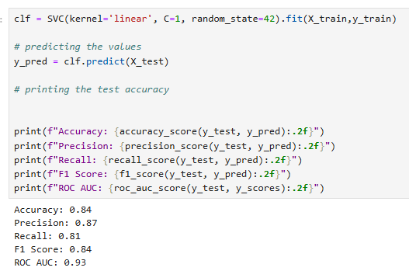
Support Vector Machines
Support Vector Machines (SVM) are supervised learning models used for classification and regression tasks. They work by finding the optimal hyperplane that separates data into different classes. SVM aims to maximize the margin, which is the distance between the hyperplane and the closest data points from each class, known as support vectors. For non-linearly separable data, SVM uses kernel functions to map data into a higher-dimensional space where it can be separated linearly. The model is effective for high-dimensional spaces and versatile due to various kernel options.
SVM Result

Slide 16
ALGORITHMS
Support Vector Machines
Logistic Regression
Decision Tree
Random Forest
Gradient Boosting Classifier
Support Vector Machines
Logistic Regression
Decision Tree
Random Forest
Gradient Boosting Classifier

Slide 17
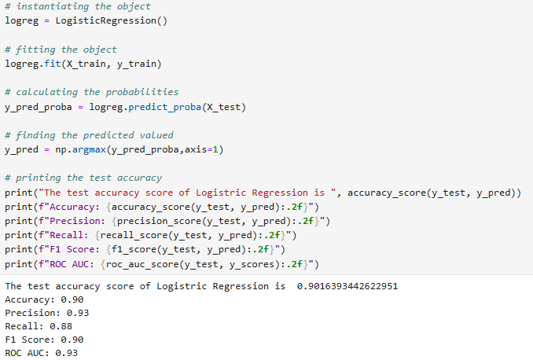
Logistic Regression
Logistic regression is a one of the machine learning classification algorithm for analyzing a dataset in which there are one or more independent variables (IVs) that determine an outcome and also categorical dependent variable (DV).
Logistic Regression Result

Slide 18
ALGORITHMS
Support Vector Machines
Logistic Regression
Decision Tree
Random Forest
Gradient Boosting Classifier
Support Vector Machines
Logistic Regression
Decision Tree
Random Forest
Gradient Boosting Classifier

Slide 19
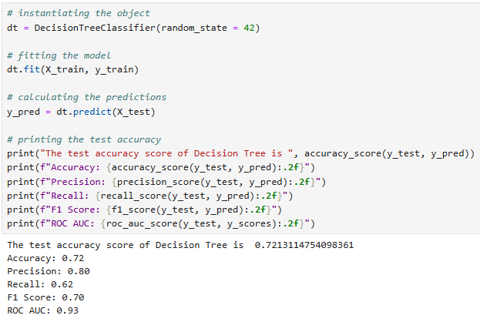
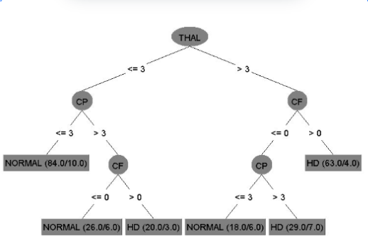
Decision Tree
Decision Tree is the most powerful and popular tool for classification and prediction. A Decision tree is a flowchart-like tree structure, where each internal node denotes a test on an attribute, each branch represents an outcome of the test, and each leaf node (terminal node) holds a class label.
From the Figure it can be interpreted, if a person whose CP value is less than or equal to 3 will be normal. A person whose CF value greater than 0 will be affected by heart disease.
Decision Tree Result

Slide 20
ALGORITHMS
Support Vector Machines
Logistic Regression
Decision Tree
Random Forest
Gradient Boosting Classifier
Support Vector Machines
Logistic Regression
Decision Tree
Random Forest
Gradient Boosting Classifier

Slide 21
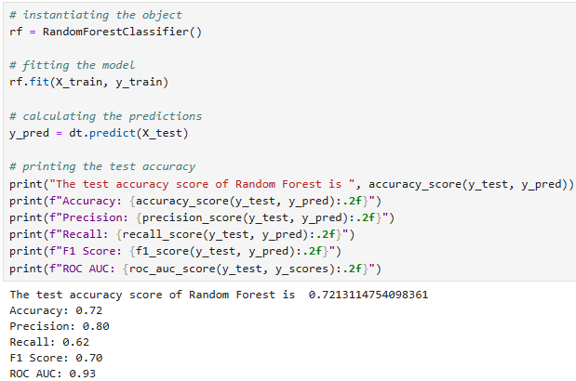
Random Forest
Random Forest is an ensemble learning method used for classification and regression tasks. It works by constructing multiple decision trees during training and outputs the mode of the classes (classification) or the mean prediction (regression) from these individual trees.
The key idea is to use a random subset of features and data samples for each tree, which helps in reducing overfitting and improving generalization. By aggregating the results from numerous trees, Random Forests offer robust predictions and are particularly effective with large datasets and complex, non-linear relationships.
The method is also relatively easy to tune and interpret.
Random Forest
Result

Slide 22
ALGORITHMS
Support Vector Machines
Logistic Regression
Decision Tree
Random Forest
Gradient Boosting Classifier
Support Vector Machines
Logistic Regression
Decision Tree
Random Forest
Gradient Boosting Classifier

Slide 23
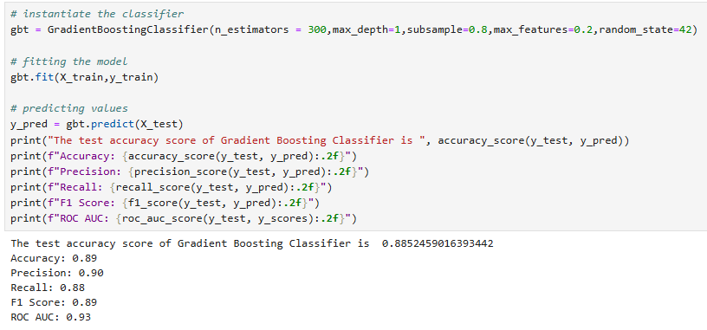
Gradient Boosting Classifier
Gradient Boosting Classifier is an ensemble learning technique that builds a series of decision trees, each one correcting errors from the previous tree. It optimizes the model by minimizing a loss function, such as log loss for classification, through gradient descent. Each new tree focuses on the residuals (errors) of the prior trees, effectively learning from past mistakes to improve accuracy. The model is trained iteratively, with each tree adding to the cumulative prediction. Gradient Boosting is powerful for complex datasets, often yielding high accuracy, but can be sensitive to overfitting if not carefully tuned.
Gradient Boosting Classifier
Result

Slide 24
ALGORITHMS
Support Vector Machines
Logistic Regression
Decision Tree
Random Forest
Gradient Boosting Classifier
Support Vector Machines
Logistic Regression
Decision Tree
Random Forest
Gradient Boosting Classifier

Slide 25
FEATURE SELECTION AND DATASET
INTRODUCTION
Prediction of Heart Attack
EDA
METHODOLOGY AND ALGORITHMS
CONCLUSION

Slide 26
CONCLUSION
Predicted exhibition of each technique and applied the proposed system for the area it required, The accuracy achieved for
Support Vector Machines is 84%,
Logistic Regression is 90%,
Decision Tree is 72%,
Random Forest is 72%,
& Gradient Boosting Classifier is 89%.

Slide 27


